Slide 1
Matthew 7:15-23
Alvin Tan
Uploaded by Dr. Rick Griffith, Crossroads International Church Singapore
www.BibleStudyDownloads.org

Slide 6
Introduction
Spotting False Prophets is a Serious Matter!
It has Eternal Consequences (Matt 5:20; 7:21-23).
It takes more than Smartness & Sharpness!
It takes Spiritual Discernment!

Slide 7
The Background
Central Theme of Matthew is “God’s Kingdom.”
Matthew 5-7 is Jesus’ lengthy exposition on :
What Kingdom Citizenship & Righteousness look like NOW?
What Human Righteousness looks like compared to GOD’S?
What could Happen if we Mistook the Difference (7:13-27)?

Slide 8
1. The Cautions Concerning False Prophets
Urgency involved “Beware…” (6 x Matthew).
Prevalence and Intensities involved “False Prophets…”
True of Jesus’ Days.
True of Apostles’ Days.

Slide 9
“Now if Christ is proclaimed as raised from the dead, how can some of you say that there is no resurrection of the dead?”
1 Cor 15:12

Slide 10
“But avoid irreverent babble, for it will lead people into more and more ungodliness, and their talk will spread like gangrene. Among them are Hymenaeus and Philetus, who have swerved from the truth, saying that the resurrection has already happened. They are upsetting the faith of some.”
2 Tim 2:15-18

Slide 11
“But false prophets also arose among the people, just as there will be false teachers among you, who will secretly bring in destructive heresies, even denying the Master who bought them, bringing upon themselves swift destruction.”
2 Pet 2:1

Slide 12
“Beloved, do not believe every spirit, but test the spirits to see whether they are from God, for many false prophets have gone out into the world…every spirit that does not confess Jesus is not from God.”
1 John 4:1-3

Slide 13
1. The Cautions Concerning False Prophets
Urgency involved “Beware…” (6 x Matthew).
Prevalence and Intensities involved “False Prophets…”
True of Jesus’ Days.
True of Apostles’ Days.
True of The Early Church.
True of End-Days.

Slide 14
“And many false prophets will arise and lead many astray. And because lawlessness will be increased, the love of many will grow cold.”
Matt 24:11-12

Slide 15
“And I saw, coming out of the mouth of the dragon and out of the mouth of the beast and out of the mouth of the false prophet, three unclean spirits like frogs. For they are demonic spirits, performing signs, who go abroad to the kings of the whole world, to assemble them for battle on the great day of God the Almighty.”
Rev 16:13-14

Slide 16
1. The Cautions Concerning False Prophets
Infiltration involved “Come to you…”.

Slide 17
“I know that after my departure fierce wolves will come in among you, not sparing the flock; and from among your own selves will arise men speaking twisted things, to draw away the disciples after them.”
Acts 20:29-31

Slide 18
“Yet because of false brothers secretly brought in—who slipped in to spy out our freedom that we have in Christ Jesus, so that they might bring us into slavery.”
Gal 2:4

Slide 19
“For certain people have crept in unnoticed who long ago were designated for this condemnation, ungodly people, who pervert the grace of our God into sensuality and deny our only Master and Lord, Jesus Christ.”
Jude 4

Slide 20
1. The Cautions Concerning False Prophets
Infiltration involved “Come to you…”.
Disguises/Deceptions involved “Sheep’s Clothing…”

Slide 21
“For such men are false apostles, deceitful workmen, disguising themselves as apostles of Christ. And no wonder, for even Satan disguises himself as an angel of light. 15 So it is no surprise if his servants, also, disguise themselves as servants of righteousness… .”
1 Cor 11:13-15

Slide 23
2. The Characteristics of False Prophets
“False…” from Gk “Pseudo”
Traces of Truth but Largely Untrue.
Similar but not the Same.
Counterfeit AAA Quality.

Slide 24
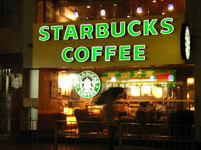

Slide 25
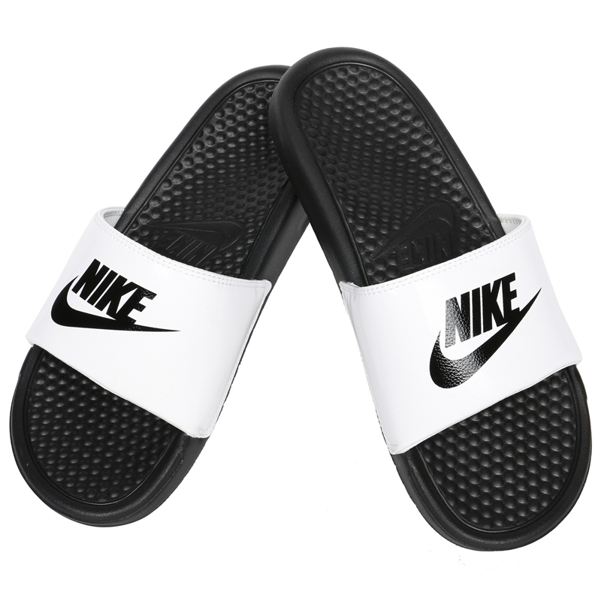
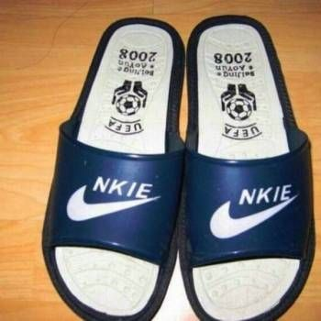

Slide 26
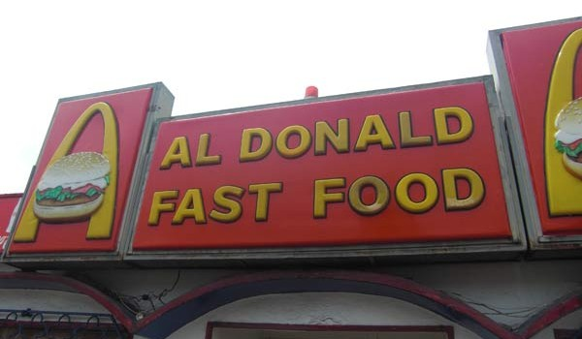
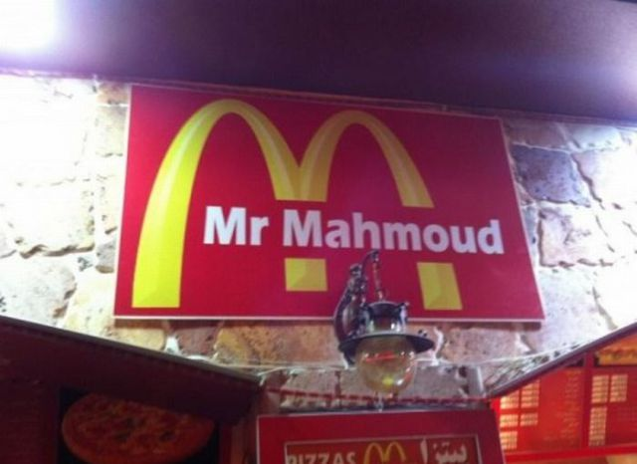
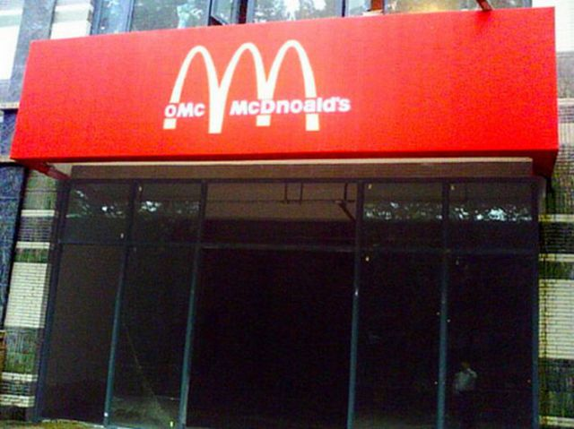
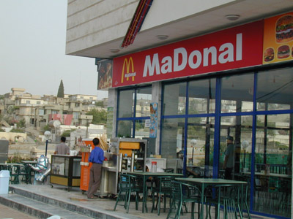

Slide 27
2. The Characteristics of False Prophets
“False…” meaning “Pseudo” – Traces of Truth but Largely Untrue - Similar but not the Same.
False Allegiance “Lord Lord…” (v21,23).
False Representations “in Your Name” (v22-23).
False Righteousness “Beware…” (6x Matt).

Slide 28
“False…” - “Pseudo” – Manifested in many forms.
False-Christs (Matt 24:24).
False-Apostles (2 Cor 11:13).
False-Brothers (2 Cor 11:26).
False-Signs and Wonders (2 Thess 2:9).
False-Words (2 Pet 2:3).

Slide 29
False Claims that “If it works” prove “Genuineness” –
“prophesy in your name…” (7:22).
“cast out demons in your name…” (7:22b).
“do many mighty works in your name…” (7:23).

Slide 30
True not False “Teachings” Validate “Genuineness” “by their fruits you will recognise them…” (v16-19).
What is being said or taught? (Matt 12:33-37 “...for by your words you will be justified…condemned)
Is it according to Scriptures? Not works (Deut 13:1–5; 18:20–22).

Slide 31
“Either make the tree good and its fruit good, or make the tree bad and its fruit bad, for the tree is known by its fruit. You brood of vipers! How can you speak good, when you are evil? For out of the abundance of the heart the mouth speaks. The good person out of his good treasure brings forth good, and the evil person out of his evil treasure brings forth evil. I tell you, on the day of judgment people will give account for every careless word they speak, for by your words you will be justified, and by your words you will be condemned.”
(Matt 12:33-37)

Slide 32
“If a prophet or a dreamer of dreams arises among you and gives you a sign or a wonder, and the sign or wonder that he tells you comes to pass, and if he says, ‘Let us go after other gods,’ which you have not known, ‘and let us serve them,’ you shall not listen to the words of that prophet or that dreamer of dreams…You shall walk after the LORD your God and fear him and keep his commandments and obey his voice, and you shall serve him and hold fast to him.”
(Deut 13:1-5)

Slide 33
No Regard for Scriptures - “workers of Lawlessness…” (23:28; 24:12; 2 Thess 2:3,7-9)
They Twisted Scriptures.

Slide 34
“I know that after my departure fierce wolves will come in among you, not sparing the flock; and from among your own selves will arise men speaking twisted things, to draw away the disciples after them.”
(Acts 20:29-30)

Slide 35
“There are some things in them that are hard to understand, which the ignorant and unstable twist to their own destruction, as they do the other Scriptures. You therefore, beloved, knowing this beforehand, take care that you are not carried away with the error of lawless people and lose your own stability.”
(2 Pet 3:16-17)

Slide 36
No Regard for Scriptures - “workers of Lawlessness…” (23:28; 24:12; 2 Thess 2:3,7-9)
They Twisted Scriptures.
They Cleverly Devised Myths.

Slide 37
“For the time is coming when people will not endure sound teaching, but having itching ears they will accumulate for themselves teachers to suit their own passions, and will turn away from listening to the truth and wander off into myths.”
(2 Tim 4:3-4)

Slide 38
“For we did not follow cleverly devised myths when we made known to you the power and coming of our Lord Jesus Christ, but we were eyewitnesses of his majesty.”
(2 Pet 1:16)

Slide 39
No Regard for Scriptures - “workers of Lawlessness…” (23:28; 24:12; 2 Thess 2:3,7-9)
Some Twisted Scriptures & Cleverly Devised Myths.
Holy Communion is God’s “prosperity” plan.
Olive Oil is the “Blood of Jesus” to heal.
There is no need for Teachings on Sins/Repentance.
The Law of God enslaves and is no Good for us.
God wants us to be Healthy and Wealthy always.
Speaking in Tongues is a sign of Baptism of Spirit.
Faith is Name-it and Claim-it.
Salvation = Christ + Something + Someone else.

Slide 41
"As long as we are here on earth, our bodies are subject to the ageing process, which is part of the divine sentence. All our bodies are decaying every day. Our brain cells are dying daily. The Holy Communion is God's solution for us to stop the decay. And even your friends will see the results. They will begin to ask you, "Hey, why do you seem to look younger and younger? You never seem to age!“ One day, when we get to heaven, we will have brand new bodies that never grow old, never tire and never look bad. Meanwhile, the Lord's Supper is how God helps us offset this process of ageing and walk in divine health. Every time you partake, you are reversing the effects of the curse or divine judgment in your body...”
- Health and Wholeness through the Holy Communion, JP.

Slide 42
Ulterior Motives - “ravenous wolves…”(Acts 20:18-35)
False Prophets are Motivated by Personal Gain.
True Prophets are Motivated to Grow Believers Spiritually.

Slide 44
3. The Condemnations of False Prophets
Rejection of Lip-service “Not everyone who says to me…” (7:21).
Rejection of Deeds “do many mighty works…I never knew you…” (7:23).
Rejection of Fellowship and Salvation “Depart from me…” (7:23).

Slide 45
Conclusion
Spotting False Prophets is a Serious Matter!
It has both Present & Eternal Consequences!

Slide 48
NT Preaching link at BibleStudyDownloads.org
Get this presentation for free!
Notes:
NT Preaching (np)

